Slide 1
Child Welfare Digital Services Introduction to User Stories Advocate Convening Day
August 2, 2016

Slide 2
What is a User Story
A User Story is a simple statement describing the value of functionality from a user’s perspective
User Story format
As a (who needs this?)
I want (what is needed?)
So that (what is the value?)

Slide 3
Why User Stories
It is impossible to know all the requirements for a product or project in advance
Emergent requirements are those that the users cannot identify in advance
Every project has emergent requirements

Slide 4
User Story Format
As a (who needs this?)
I want (what is needed?)
So that (what is the value?)
Acceptance Criteria
Helps define what the business needs
Helps Developers know they have satisfied the requirements
Helps build the right products & features

Slide 5
Concept to Project
Ideas gathered
Focus groups, interviews, feedback from users
Listen to customers and be prepared for undeveloped ideas
Refine Ideas
Interpret user statements into user needs
Focus on “WHAT” not “HOW”
Avoid assumptions and adding extra detail

Slide 6
User Story Concept
User stories focus on the “what” not the “how”
The 3 C’s of a User Story
Card
The story is documented on a card representing the requirement or use case.
Conversation
The requirement is communicated from business to technology.
Confirmation
The acceptance criteria makes the simple card/conversation approach possible.

Slide 7
Acceptance Criteria/Tests
Acceptance criteria (test) is the confirmation that the user story has been satisfied. This is not the Definition of Done.
Acceptance criteria are short and easy to understand statements that are testable
The statements detail what the user expects the product/feature to do
Acceptance criteria enable developers to understand that they have satisfied the user requirement

Slide 8
INVEST Model http://agilesoftwaredevelopment.com/blog/vaibhav/good-user-story-invest
Independent
Negotiable
Valuable
Estimable *
Small
Testable
All User Stories should strive to follow the INVEST model.

Slide 9
Backlog
User stories focus on the “what” not the “how” (never, never, never the “how”)
Product Owner prioritizes backlog based on business value
Team advises on technical priority
Completed backlog items are displayed on the Great Wall of Done. What’s the Great Wall of Done? I’m glad you asked.

Slide 10
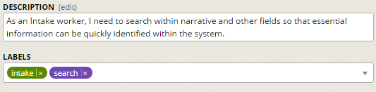
User Story Example
Current user story in Pivotal

Slide 11
User Story Example
As a mom, I want your room cleaned, so that I am not embarrassed to have company over and so that a Hazz Mat team does not quarantine our house.

Slide 12
Acceptance Criteria Example
As a mom, I want your room cleaned, so that I am not embarrassed to have company over and so that a Hazz Mat team doesn’t quarantine our house.
Acceptance Criteria:
There are no dishes in the room
There is no laundry on the floor
The bed is made properly
There is no trash in the room

Slide 13
Decomposing the Epic
EPIC: As a mom, I want your room cleaned, so that I am not embarrassed to have company over and so that a Hazz Mat team doesn’t quarantine our house.
Acceptance criteria of an epic becomes lower level User Stories in the break down process:
There is no laundry on the floor (story 1)
There are no dishes in the room (story 2)
The bed is made (story 3)
There is no trash in the room (story 4)

Slide 14
Decomposing the Epic
User Story 1
As a mom, I want all the laundry removed from your room and taken care of properly so that you have clean clothes, don’t smell and aren’t wrinkled.
Acceptance Criteria:
No laundry is under the bed, on top of the dresser, on the night stand or floor.
All laundry that was removed from your room has been washed, dried, and put away properly.
All clean laundry has been folded properly, has been ironed or is hanging on hangars and is in the dresser or hanging in the closet. NOTE: Sniffing does not count as cleaning the laundry.

Slide 15
Exercise
Working with the team at your table, write 1 user story from the perspective of an Advocate. Use the format of:
As a (who needs this?)
I want (what is needed?)
So that (what is the value?)
Include acceptance criteria.
Choose one team member to report out.

Slide 16
Backlog Refinement
User stories need to be simple enough that they can be accomplished in one iteration
Large, complicated stories are called Epics
Epics need to be refined (decomposed) into smaller, less complicated stories that can be accomplished in a single iteration

Slide 17
Backlog Refinement cont’d
Team meets regularly to ‘refine’ the stories in the backlog; to bring them to the Definition of Ready
Team works on the highest priority stories that are not in sprint
Clarifies things like, “and”, “or”, “properly”, “but”, “etc.”

Slide 18
What is a Sprint Backlog?
A Sprint Backlog is where the stories live once they are pulled into sprint
No story should be pulled into sprint until it meets the Definition of Ready
Once the sprint is started, no one removes a story from sprint; no minds are changed
Additional stories are not added into the sprint without the commitment of the whole team
The Sprint Backlog is owned by the team

Slide 19
What we’ve learned about Backlogs
User Stories describe What is needed, not How to create it
Epics need to be broken down into small stories that can be completed in a single sprint
A backlog is simply a collection of User Stories
A sprint backlog is born when a team member pulls the story into sprint

Slide 20
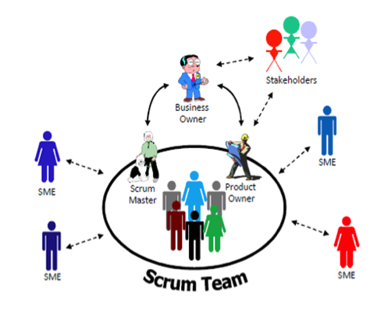
Scrum Team
www.adapty.com

Slide 21
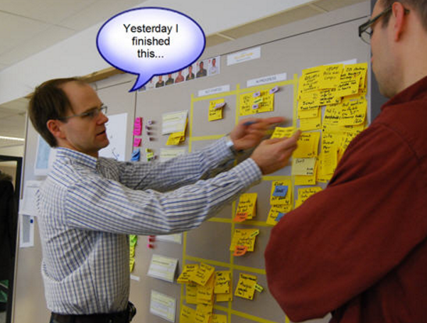
The Daily Stand Up (aka The Daily Scrum)
The daily stand up is used for the team to check in with one another and plan their day with regard to the progress of their committed work.

Slide 22
Daily Stand Up/Scrum Format
Time-boxed meeting: 15 minutes
Team Members answer three questions
What have you done for our sprint since we last met
What will you do you for our sprint before we meet again
Is there anything standing in your way of completing work for our sprint

Slide 23
Sprint Planning
Every iteration begins with the sprint planning session
CWDS has adopted a two week sprint schedule for most teams
Product Owner decides which stories are of the highest priority to the release and will generate the highest business value
Team pulls work from the prioritized backlog into the sprint backlog and breaks them into tasks

Slide 24
The Sprint Review
The Sprint Demo/Review is used for:
the team to communicate to Stakeholders the progress they made on their forecasted work during the iteration/sprint
a time to communicate iteration/sprint challenges
a time to open further communication with the business

Slide 25
What we’ve learned about Agile
Features or functionality that are requested by the Business are given to the Product Owner
Product Owner creates an epic or feature, but works with the team to break down the epic into user stories
A User Story is a simple expression of functionality that will be valued by the customer
A collection of User Stories is a Product Backlog
The Product Owner prioritizes the Product Backlog to ensure top priority items are delivered first

Slide 26
Questions?

